Slide 1
FOREST FIRES
By
Dinesh
Sowjanya
Archana
Jagadish
Aseeth Vardhan

Slide 2
Introduction
A forest fire is a natural disaster consisting of a fire which destroys a forested area, and can be a great danger to people who live in forests as well as wildlife. Forest fires are generally started by lightning, but also by human negligence or arson, and can burn thousands of square kilometers.
Forest fires, also known as wildfires, vegetation fire, grass fire, brush fire or bush fire, is common in vegetated areas of Australia, South Africa, United States and Canada, where climates are sufficiently moist to allow the growth of trees, but feature extended hot and dry periods.
Forest fires are caused by the drying out of branches, leaves and therefore becomes highly flammable.

Slide 3
Features and labels
X,Y points refers to axis
Month Day
FFMC-It is a numeric rating of the moisture content of litter and other fine fuels.It varies from 18.7 to 96.20
DMC-It is the numeric rating of the avg moisture content of loosely compacted oragnic layers.

Slide 4
DC-The numeric rating of the avg moisture content of deep compact organic layers. (indicator for drought effects)
ISI-It is a numeric rating of expected rate of fire spread(wind , FFMC)
Temperature , wind , relative humidity , rain are also the features which effect area.

Slide 5
Area-It is the burned region of forest .(0.0-1090.84)
The given dataset is free from missing values.
Linear Regression is applied to this since the output is numeric data and it is not dichotomous and trichotomous data.

Slide 6
Exploration of data analysis
The data set consists of 12 features and 1 label i.e.(inputs,output)
It is a regression analysis but mainly deals with detection of outliers.
Since the data consists of many outliers,The accuracy score will be very low . so they are to be normalized . Normalization helps in solving the issues with outliers.

Slide 7
In order to say the model is best it is based on the factors.
ACCURACY(high)-difference between experimental and accepted value.
MEAN SQUARED VALUE-The model with lesser RMSE is better
R2 SCORE-It represents proportion of variance for a dependent variable to an independent variable.

Slide 8
Data visualisation
It is the graphical representation of data and information.visual elements like graphs,maps,charts are used.
To communicate clearly and efficintly data visualisation is done.
The techniques used in this are 1.Box plots
2.Scatter plots
3.Distribution plots
Detection of outliers is easily done using these techniques.

Slide 9
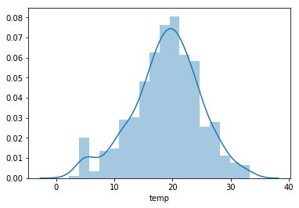
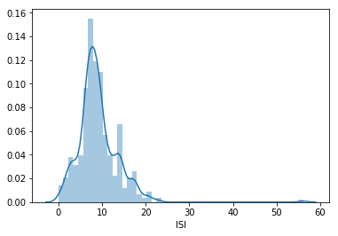
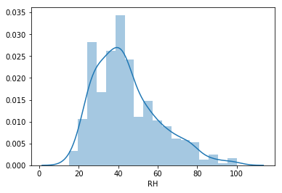
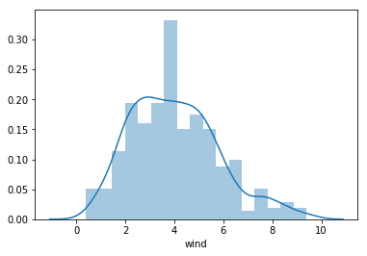
Distribution Plots

Slide 10
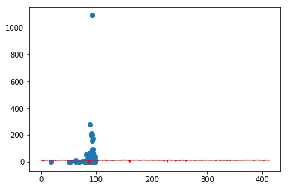
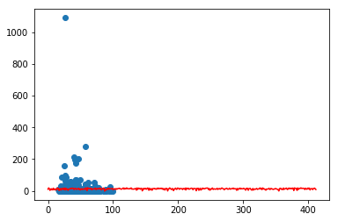
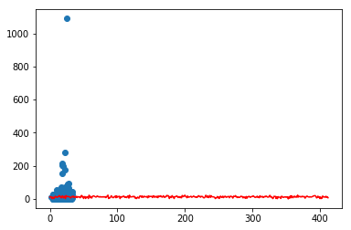
Scatter Plots

Slide 11
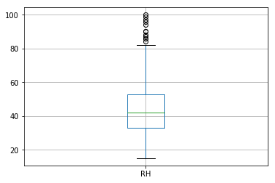
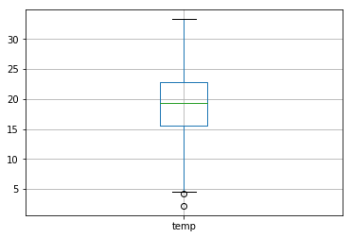
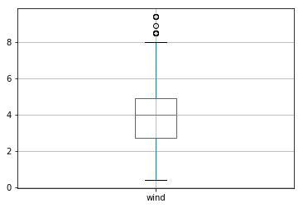
Box plots

Slide 12
Simple linear regression
s.no | Features | Accuracy | RMSE | R2score
1 | FFMC | 0.24 | 62.86 | 0.24
2 | DMC | 1.05 | 62.61 | 1.05
3 | DC | 0.25 | 62.86 | 0.25
4 | ISI | -0.11 | 62.98 | -0.11
5 | temp | 1.66 | 62.41 | 1.66
6 | RH | 0.85 | 62.67 | 0.85
7 | wind | 0.01 | 62.94 | 0.01
8 | rain | -1.7 | 63.5 | -1.7

Slide 13
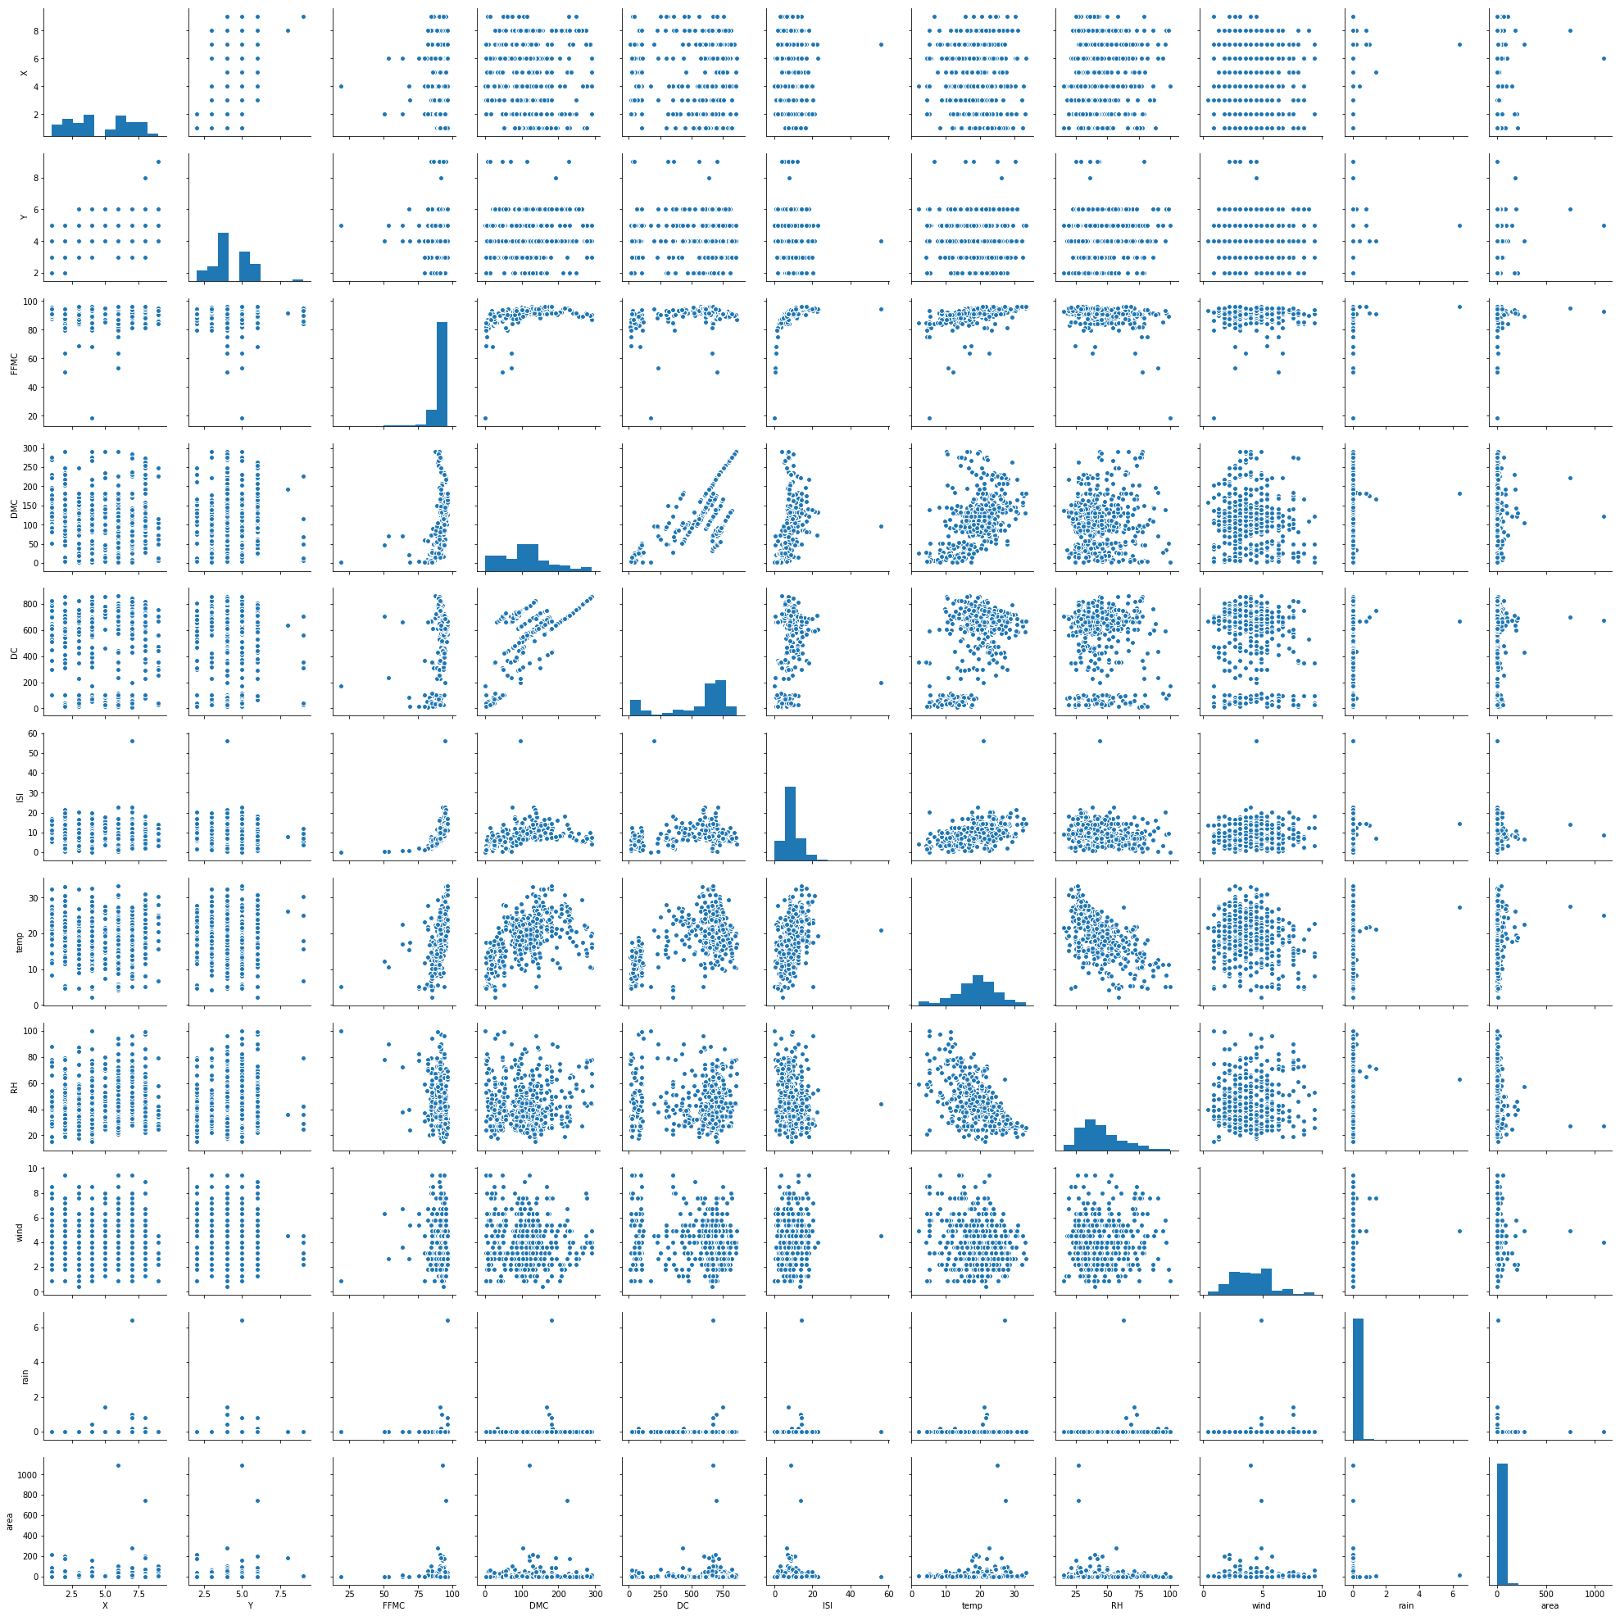
Pair Plots

Slide 14
Linear Regression
Linear regression is a statistical approach for modelling relationship between a dependent variable with a given set of independent variables.
In order to provide a basic understanding of linear regression, we start with the most basic version of linear regression, i.e. Simple linear regression.
Simple linear regression is an approach for predicting a response using a single feature.

Slide 15
Multiple Linear Regression
Multiple linear regression attempts to model the relationship between two or more features and a response by fitting a linear equation to observed data.
Clearly, it is nothing but an extension of Simple linear regression.

Slide 16
Multi linear regression
s.no | Features | Accuracy in % | RMSE in % | R2score in %
1 | DC,temp | 1.22 | 75.87 | 1.22
2 | DMC,RH | 1.52 | 75.75 | 1.5
3 | X,Y,DMC | 1.23 | 75.86 | 1.23
4 | FFMC,DMC,RH | 2.98 | 61.86 | 2.98
5 | FFMC,RH,temp,wind | 2.26 | 62.86 | 2.2
6 | FFMC,RH,temp,wind,dmc | 3.26 | 61.99 | 3.26
7 | FFMC,RH,temp,wind, DMC,ISI,rain,DC | 3.69 | 61.7 | 3.61

Slide 17
Predictions and analysis of models
Initially a very lesser accuracy is retrieved using linear regression.
Outliers are to be removed in order to get better accuracy
Since given data is numerical outliers can be replaced either with mean or median.
Algorithms applied are linear regression analysis,svm,logistic regression,Random forest.

Slide 18
In the above analysis we got very lesser accuracy.
So we use Random forest regressor to the entire data rather than splitting into training and testing set.
Considering only test set we get very very lesser accuracy
We can even use classification techniques considering value equal to zero as one class and greater values in another class.

Slide 19
How do Random Forests work?
A Random Forest is an ensemble technique capable of performing both regression and classification tasks with the use of multiple decision trees and a technique called Bootstrap Aggregation, commonly known as bagging.
What is bagging you may ask? Bagging, in the Random Forest method, involves training each decision tree on a different data sample where sampling is done with replacement.

Slide 20
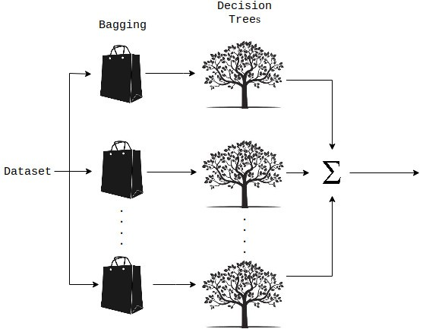

Slide 21
Values in classification methods:
Method name | accuracy
Logistic regression | 54.66
Random forest classifier | 51.92
SVM | 47.33

Slide 22
The basic idea behind this is to combine multiple decision trees in determining the final output rather than relying on individual decision trees.
If you want to read more on Random Forests, I have included some reference links which provide in depth explanations on this topic.

Slide 23
Conclusion
Finally the best model is retrieved in Linear Regression after normalizing the data i.e. removing all the outliers.
The normalization is done using random forest regressor
Entire data is considered in this scenario. because of splitting there is a lot of deviation in accuracy.
The accuracy after applying RFC is 88.7%
RMSE error is 34.41

Slide 24


